Slide 1
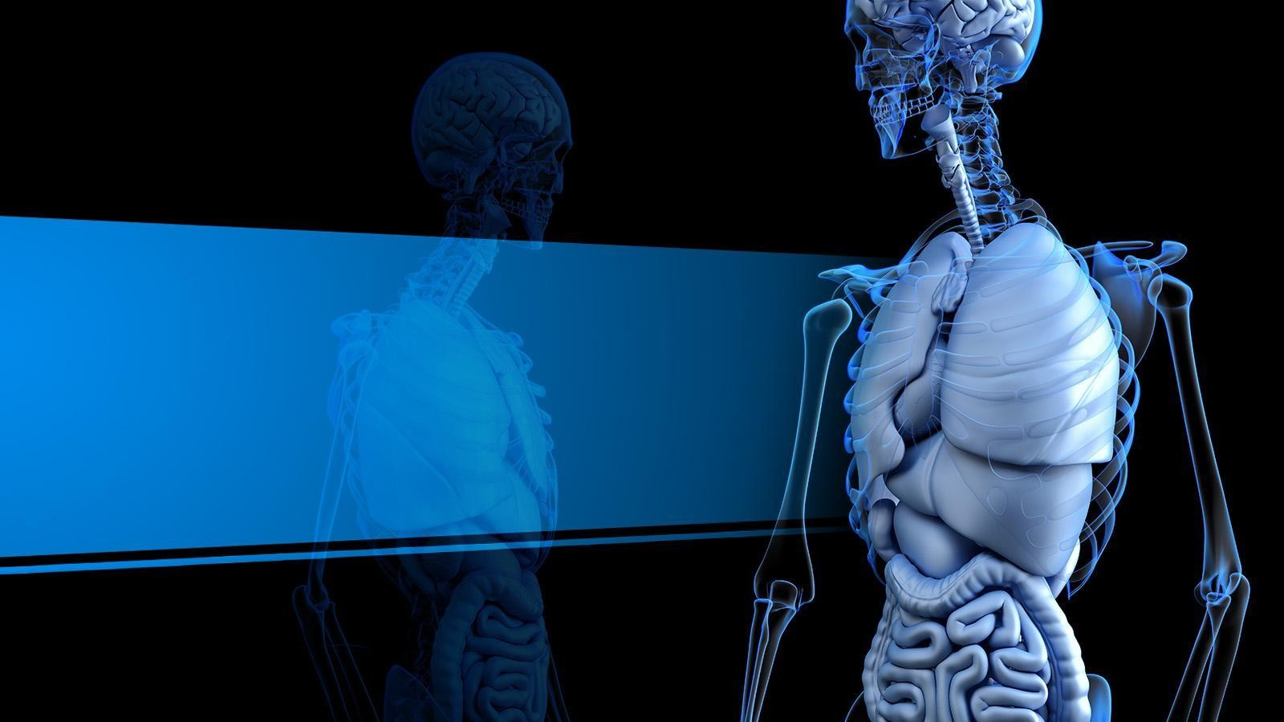

Prediction model for Kidney disease
Sarwat Zabeen

Slide 2



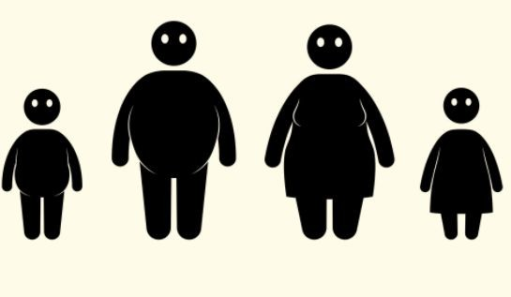
Introduction
Kidney disease is a global public health problem and is related to serious mortality.
In 2019, number of cases worldwide was 69.7 million.
The global prevalence of Kidney disease was 9.1% in 2019.
Diabetes High blood pressure Smoking
Obesity

Slide 3
BUSINESS PROBLEM
Over 1.4 million patients receiving renal replacement therapy worldwide
Lack of conclusive research on any early detection system based on lifestyle/behavioral factors
Explore whether demographic and lifestyle factors can lead to prevention or early detection of kidney disease.

Slide 4
BUSINESS IMPACT
Organizations in the healthcare space can benefit profoundly from this research and monitor early risk factors or risky behavioral patterns.

Slide 5
Approach and data Source
Secondary Data
The Behavioral Risk Factor Surveillance System data is a dataset available directly from the CDC website
Published Yearly

Slide 6
Tools and Techniques
Five predictive models utilized. These are
logistic regression
random forest
decision tree
SVM
naive Bayes

Slide 7
Methodology
Python utilized for data cleaning and only the variables relevant to this analysis will be retained
Data Cleaning
Check Assumptions and Fit Model
Compare model performance/accuracy

Slide 8
Expected Results
From this project we intend to design a model which will forecast the early detection of chronic kidney disease.
Determination of factors linked with kidney disease.
Using Decision tree model, data set will be broken down into smaller subsets to identify useful data.

Slide 9
T I M E L I N E S L I D E
Data Cleaning
Checking Model Assumption
Week1
Week3
Week5
Week2
Week4
Literature review
Planning the Step/ procedure
Using Proper Sampling Technique Exploratory Data Analysis
Run Model and Compare results

Slide 10
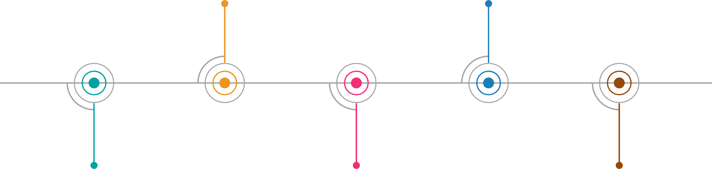
T I M E L I N E S L I D E
Hyperparameter Turning ROC AUC
Compare Results Again
Week6
Week8
Week10
Week7
Week9
Run Models
Try Different Sampling technique
Results and Future Directions

Slide 11
Data cleaning
We replaced missing values with mean value
Data imbalanced

Slide 12

Dealing with Imbalanced Dataset

Slide 13
Data cleaning contd.
Data imbalanced
13,332 participants have kidney diseases and 340,269 participants do not have kidney diseases.
Respondents who have kidney diseases are approximately four percent of the total.

Slide 14
Kidney Disease by State
Kidney Disease Prediction - Sarwat Zabeen | Tableau Public

Slide 15
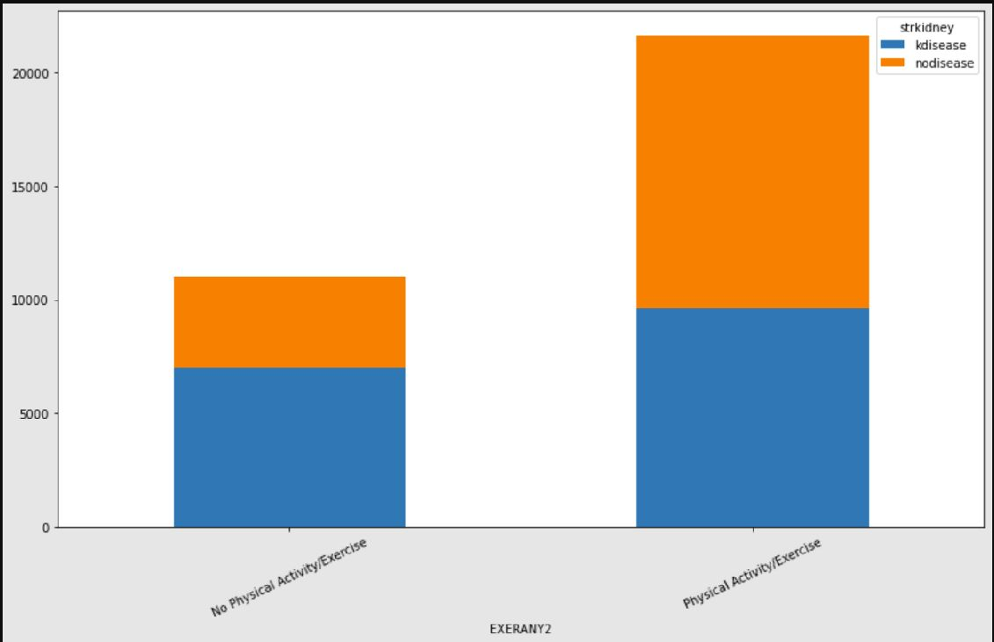
Kidney Disease Vs Exercise

Slide 16
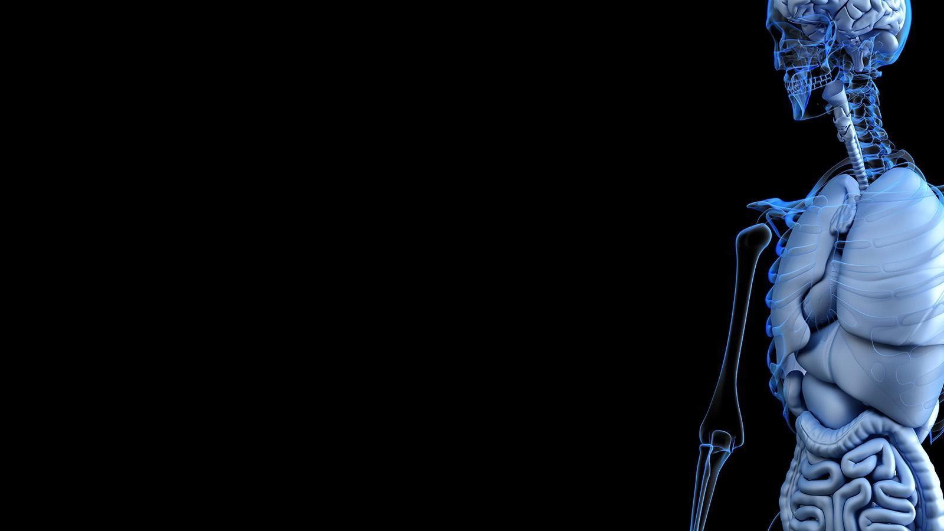
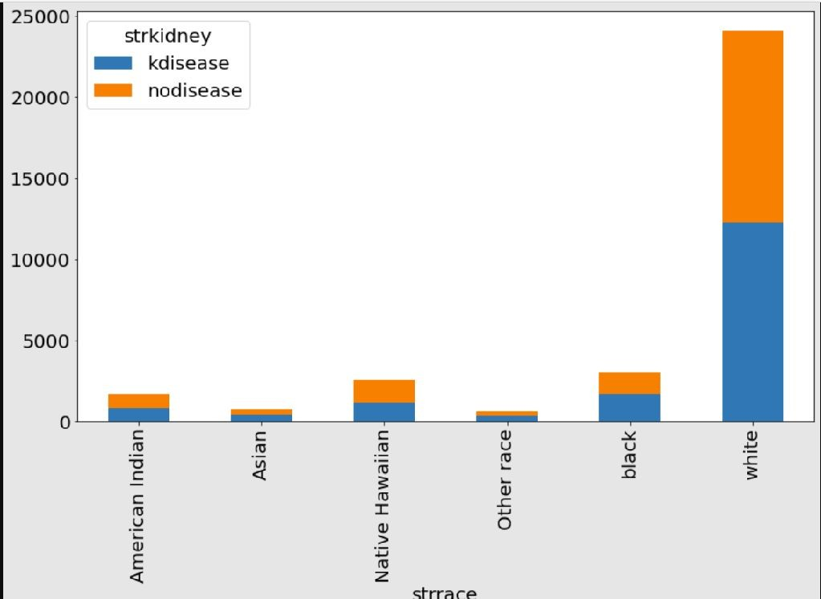
Race and Kidney disease

Slide 17
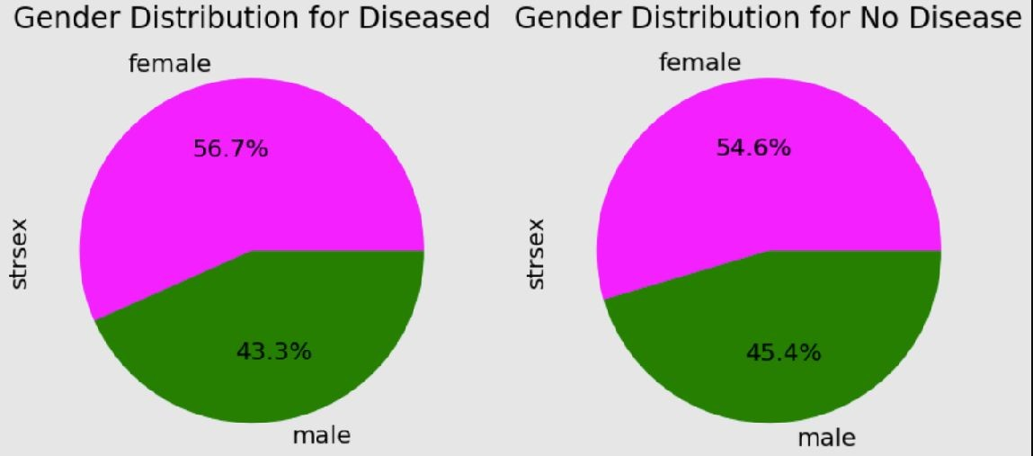
Sex and Kidney disease

Slide 18
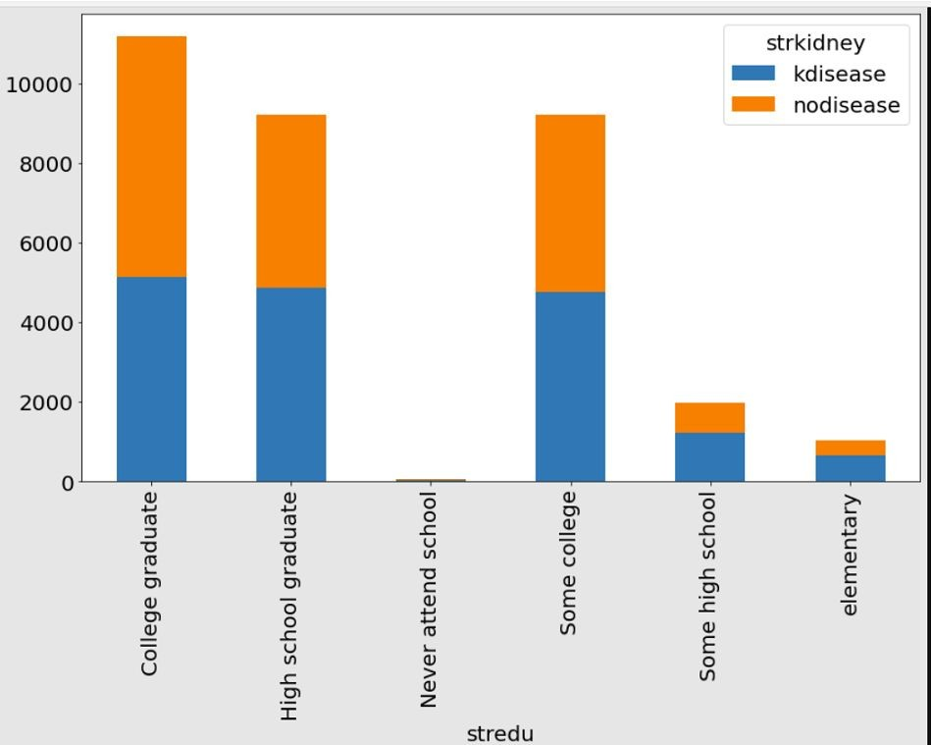
Education and Kidney disease

Slide 19
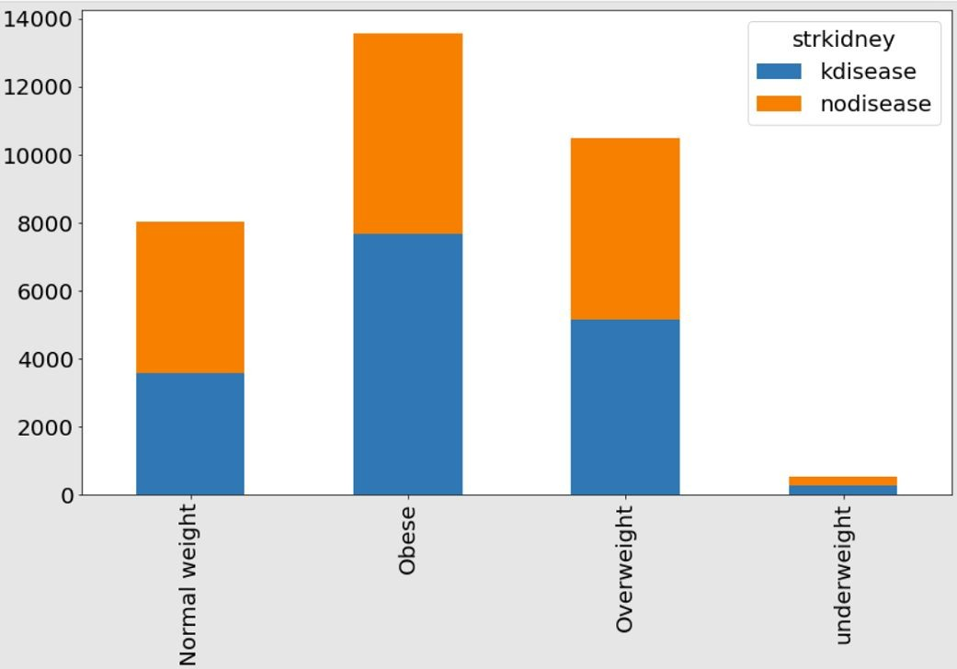
BMI and Kidney Disease

Slide 20
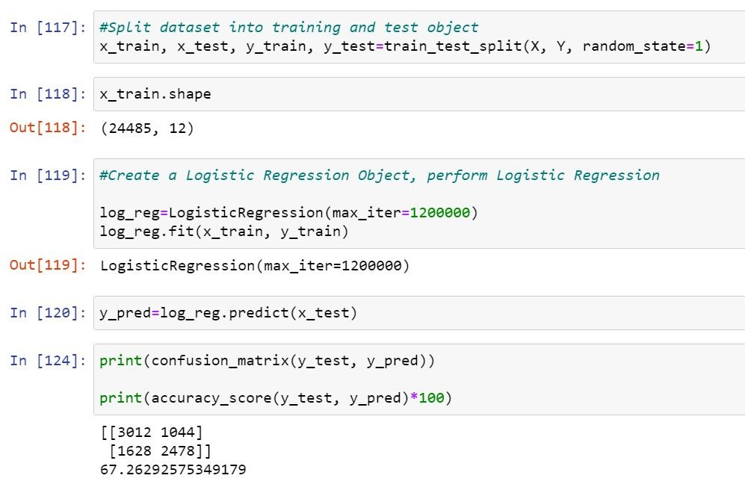
Logistic Regression Full Model

Slide 21
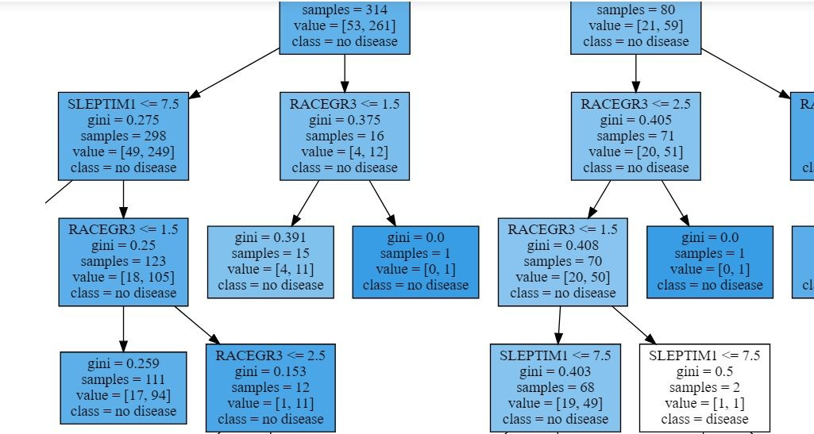
Visualizing the tree(How Race is branching out)

Slide 22
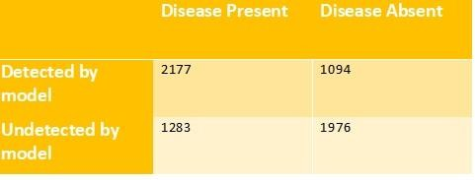
RF model confusion matrix

Slide 23
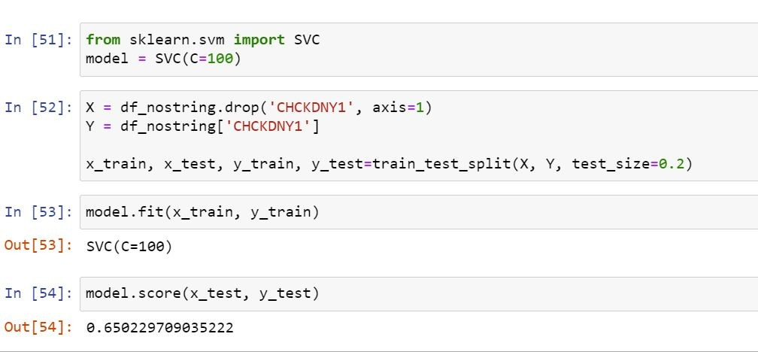
SVM with C=100

Slide 24
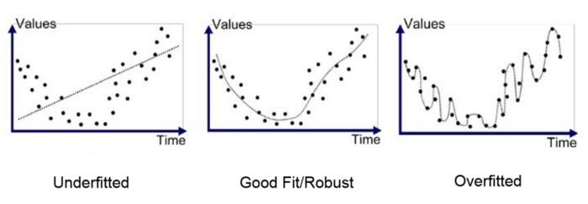
Regularization and Overfitting

Slide 25
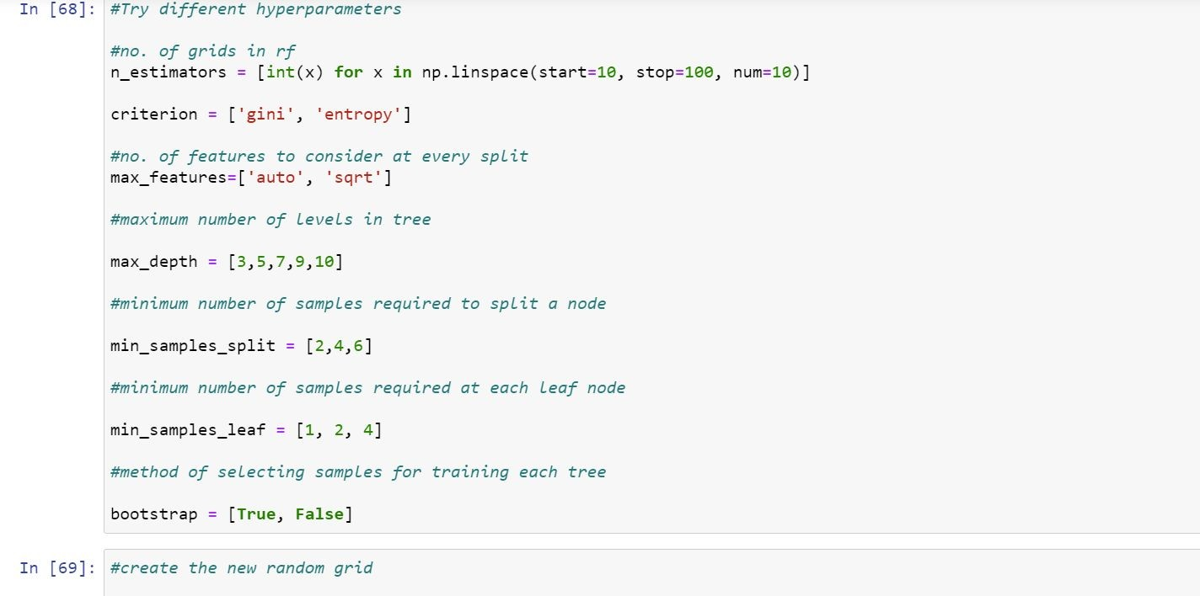
Try different hyperparameter

Slide 26
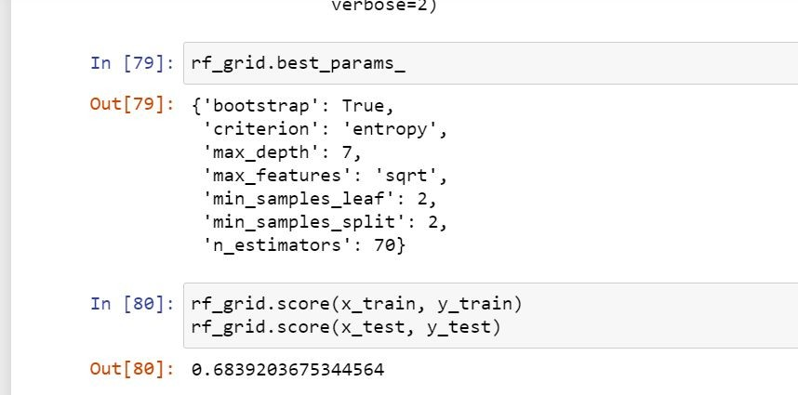
Best parameters

Slide 27
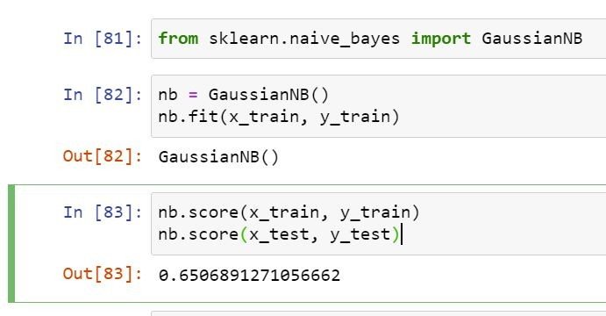
NB output

Slide 28
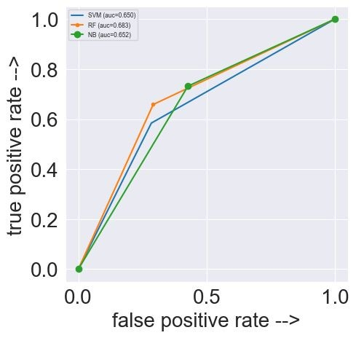
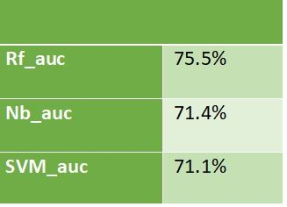
ROC AUC

Slide 29
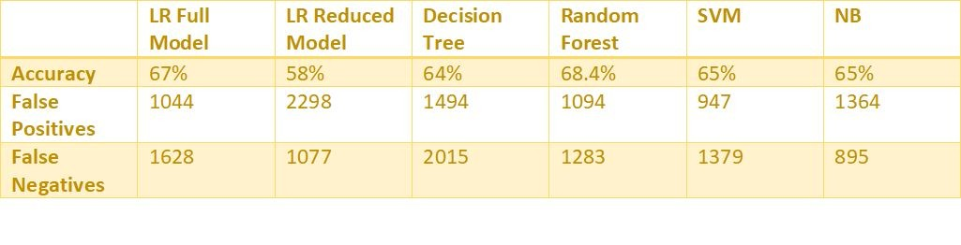
Let’s compare Again

Slide 30
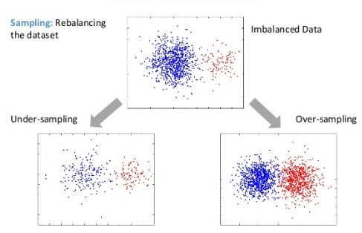
Oversampling Vs Undersampling

Slide 31
Advantages and disadvantages
Advantages:
Does not discard potentially useful data
Rich, more representative of the population
Disadvantages:
Overfitting likely
Increases learning time

Slide 32
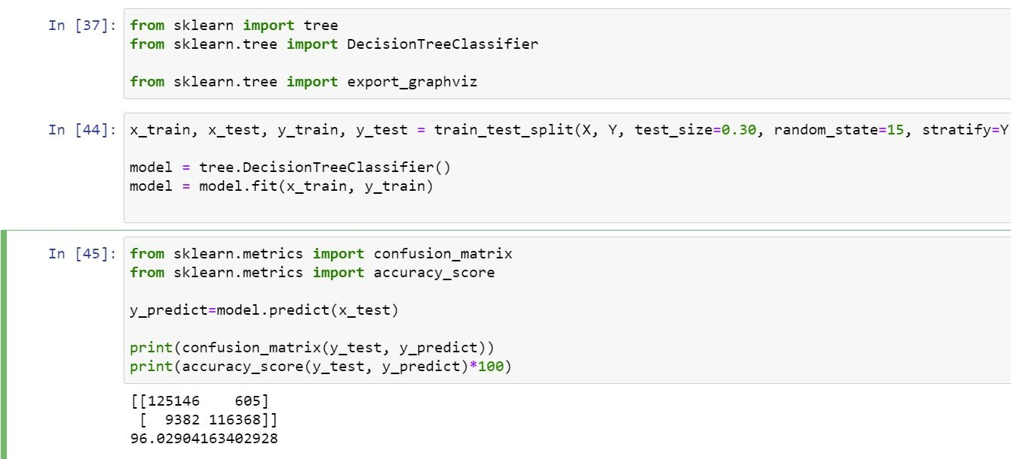
Decision Tree

Slide 33
Results/Conclusion
Likelihood of getting kidney disease can be predicted using factors such as sex, race, BMI, exercise, smoking, education, amount of sleep and employment status.
Decision Tree is the most accurate model in making such predictions. However, should be used with caution since RF is lower

Slide 34
Direction for Future Work
National Kidney Foundation highlights the important of drinking adequate water in preventing kidney disease
It also cites too many OTC painkillers as a common cause of kidney disease
CDC can incorporate these measures into
BRFSS

Slide 35
Thank you
Internal

